Slide 1
SMART IRRIGATION USING AI
Under guidance of
Mr . Gopalakrishnan B
Faculty,
BIT,
Sathy.
201EC130 - Iniyan PC
201EC130 - DhanushRoopan D
201EC192 – Malcom Vijay Josephraj D

Slide 2
Abstract
As Water supply is becoming scarce in today’s world it becomes extremely important to conserve and use water efficiently and effectively. Keeping this essential factor in mind, this projects concentrates on the principal factor of making the optimum usage of the available water. It helps by automatically controlling the water flow for the required crops by measuring their moisture level , humidity and temperature which are being intimated to the user by a mobile app. This system also helps us to conserve time and by making ideal usage of water. It’s not only applicable for farms but also in parks and lawns.

Slide 3
A microcontroller ( NodeMCU) is taken and is programmed in such a way that it monitors the sensors usage .Temperature , Rain and Humidity sensors are put into use for obtaining the respective data’s. Then soil moisture level , humidity and temperature are being monitored and taken into account. Every hour the measured values are being averaged and are compared to the previous values for further processes. The model is trained in such a way that it analyzes the previous readings and acts accordingly. If the measured values seems to exceed the threshold values the sufficient amount of water is put into use.The user gets the information of the sensor values for desired time and for every hour the action carried by the model is intimated to the user. In this regard , water is being used effectively and crop’s requirement is fulfilled. This helps us in getting the desired yield and fulfilling the objective of conserving water .

Slide 4
Problem Statement Addressed
Though people are suffering due to water scarcity , there ain’t a proper system for monitoring water usage. It becomes important to conserve water which results in further environmental usage. Mainly the irrigation work done by farmers require more precision which results in proper yield.

Slide 5
Existing Solution to the Problem Addressed
There are system’s which regulates water flow if the temperature exceeds the threshold value or when the field lacks water which are sensed using respective sensors.

Slide 6
Proposed Solution to the Problem Addressed
1)This project deals with making an optimum usage of available water source .
2)By using the temperature sensor and raindrop sensor the temperature,humidity and moisture levels of the field are calculated and noted for every 5 minutes.
3)All the programmable works are being done and the Node MCU plays a major role,here it is used for the interfacing purpose.
4)The obtained sensor values are tabulated in a google sheet which are used for further calculations.
5)The model is developed in such a way that it analyzes the present condition(values) with that of previous ones and works accordingly.

Slide 7
6) For every hour the respective values are clustered and calculated.
7) Then they are compared with their respective threshold values(they may change according to the soil and crop) and the system decides on whether the water flow is needed or not .
8)The values are intimated to the user by a mobile app. The user may know the stats and working of model by using it.
9)The app is developed using MIT App Inventor and is made into use. It’s user friendly and is apt for this model. In this way the main objective of precised water flow is obtained.

Slide 8
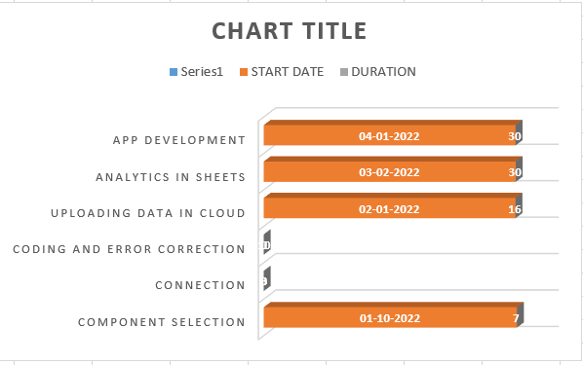
Project Work Plan

Slide 9
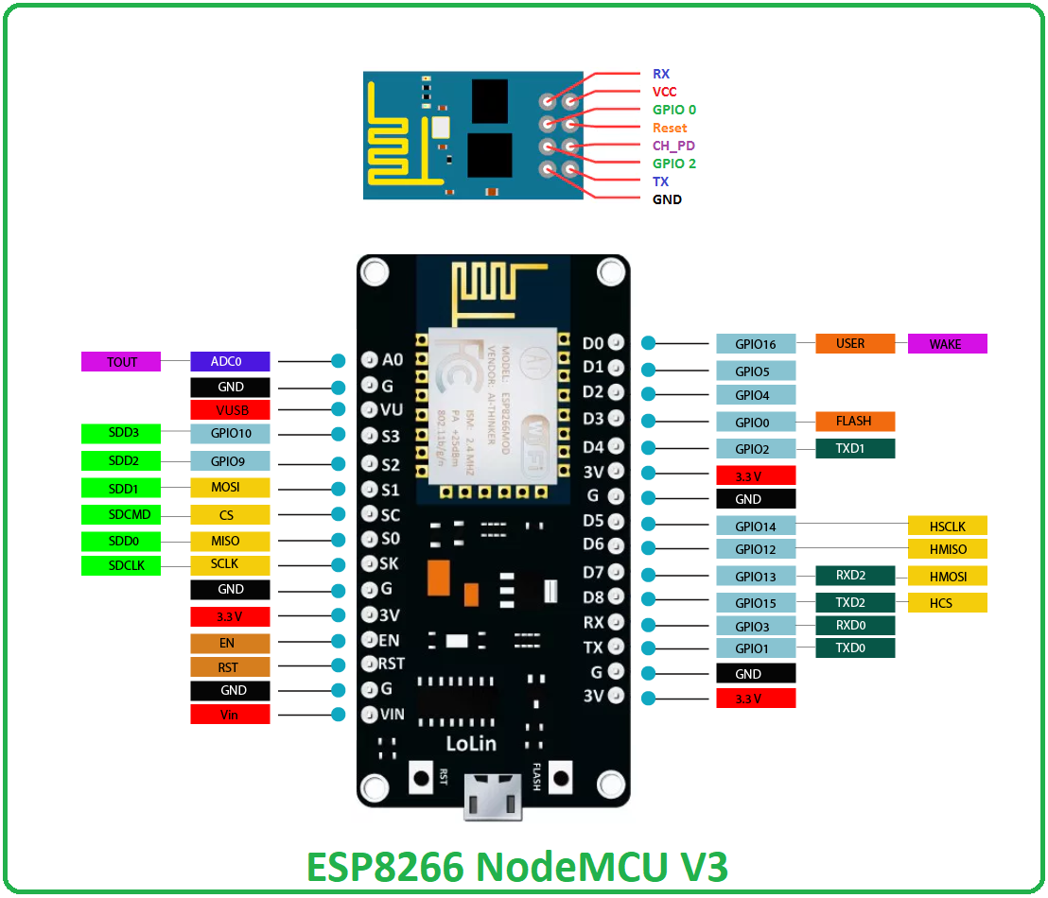
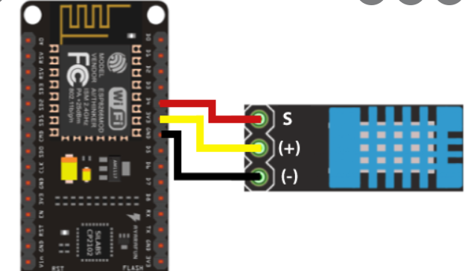
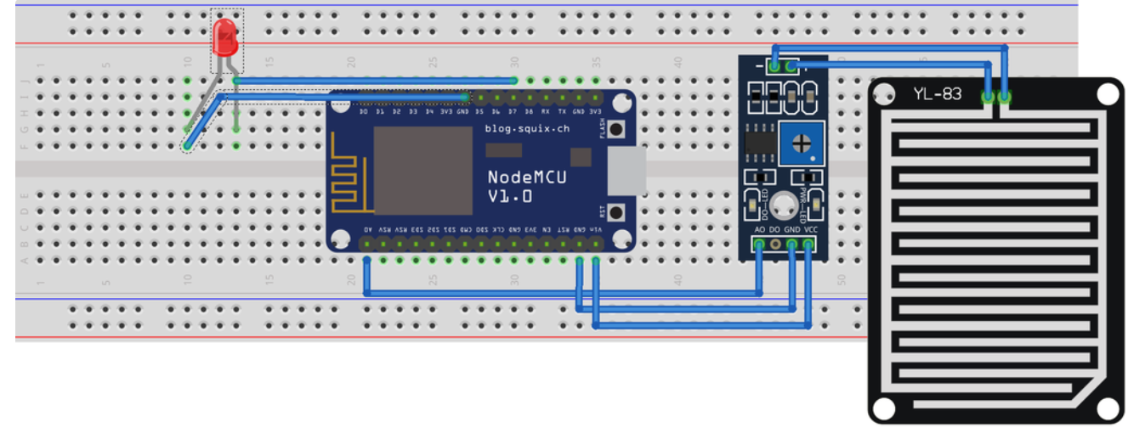
Block Diagram and/or Circuit Diagram

Slide 10
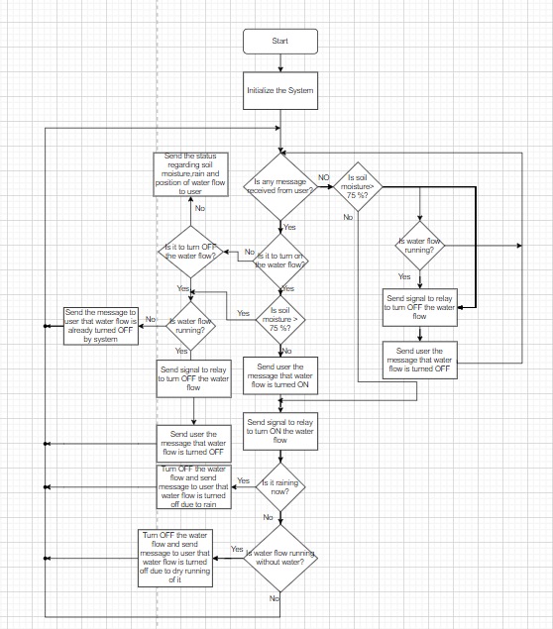
Flow Chart

Slide 11
Effective utilization of the Modern Tool & Cloud
Google sheets is put into use for analytic part. Since it’s an open source and is suitable for doing analytics it’s used here. It can be used to store the values and is user friendly too,thereby it finds it’s application here .
MIT App Inventor is a portal to create apps.We have used it to create an user friendly app which enables to send the values to the user. The performance graph and working status can also be viewed by the user.

Slide 12
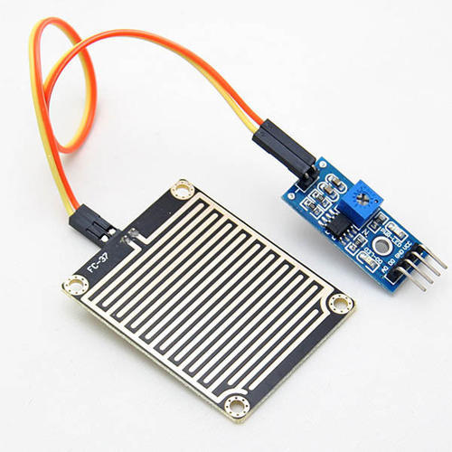
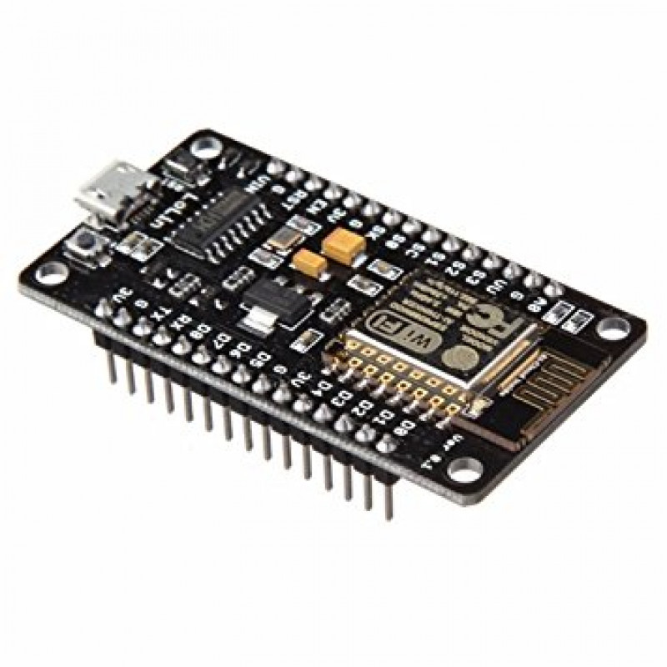
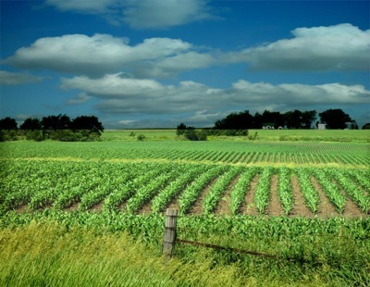
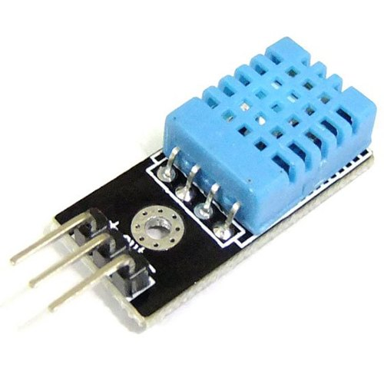


Technology stack & use case
→
RAINDROP SENSOR
→
→
NODE MCU
AGRICULTURE LAND
TEMPERATURE SENSOR
→
GOOGLE SHEETS(VALUES STORED)
→
APPLICATION FOR USERS

Slide 13
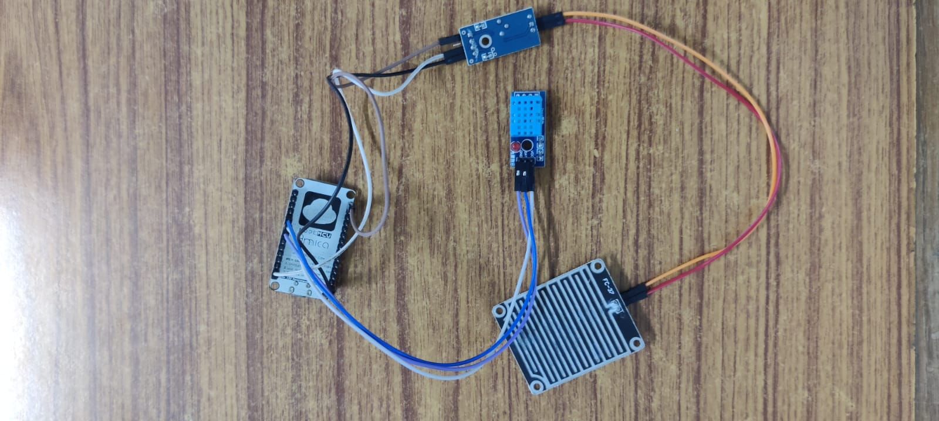
Prototype & Sample Output

Slide 14
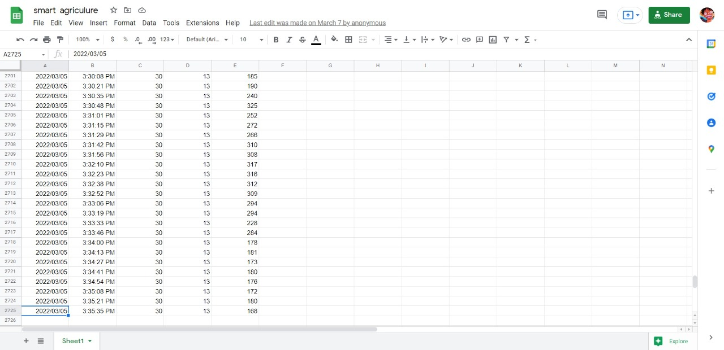
Analysis of Results & Discussions

Slide 15
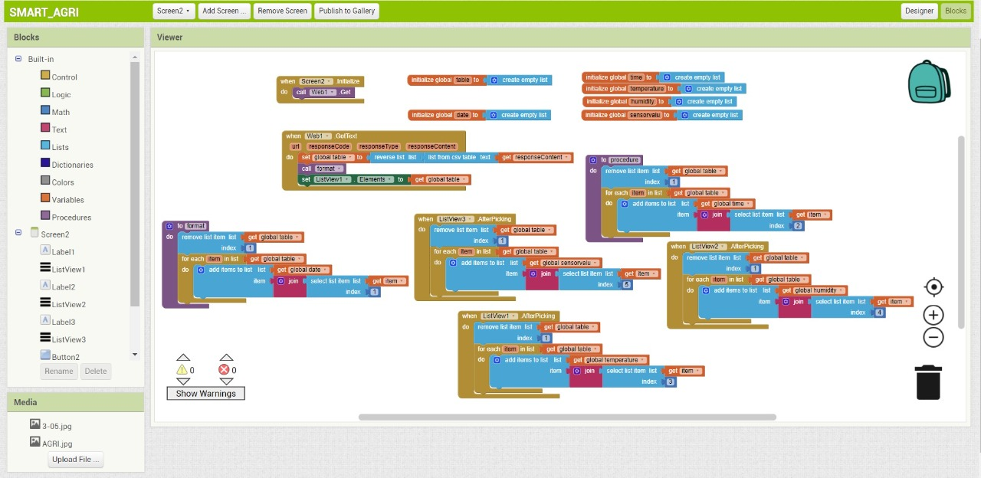

Slide 16
Cost Benefit Analysis (List of Components / Service Used)
(Budget)
S.No | Component Name | Specification (IC number or Range or Value) | Unit Cost | Total Cost(INR)
1 | Raindrop sensor |  | 1 | 105
2 | Temperature sensor |  | 1 | 196
3 | Node MCU |  | 1 | 300

Slide 17
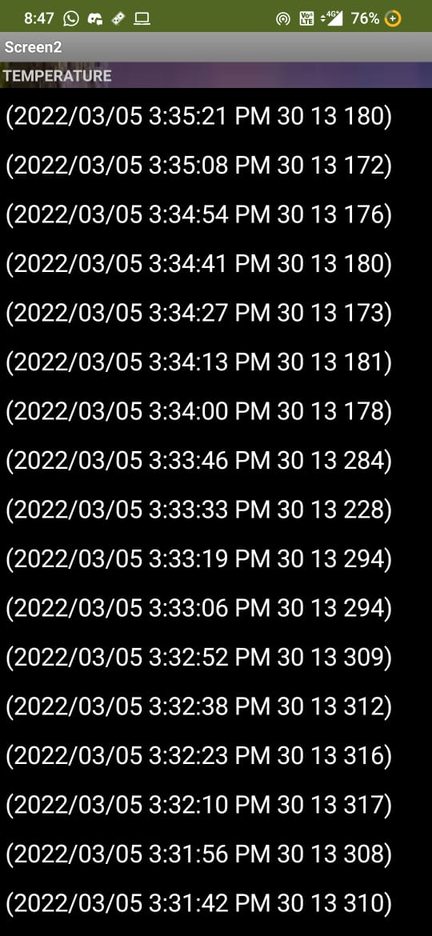
Working video Link (If available)

Slide 18
Reference
https://www.amazon.in/Irrigation-Water-Power-Engineering-Punmia/dp/8131807630/ref=asc_df_8131807630/?tag=googleshopdes-21&linkCode=df0&hvadid=396989291412&hvpos=&hvnetw=g&hvrand=12606517211238016750&hvpone=&hvptwo=&hvqmt=&hvdev=c&hvdvcmdl=&hvlocint=&hvlocphy=9299479&hvtargid=pla-406644472455&psc=1&ext_vrnc=hi

